Slide 1
Welcome!
Sunday
Bible Study 9:30 AM
Worship 10:30 AM
Wednesday
Bible Class 7:00 PM
www.SunsetchurchofChrist.net

Slide 2
John 8:21-30
Jesus reveals His goal
Belief in Jesus
Speaking from the Father

Slide 3
Welcome!
Sunday
Bible Study 9:30 AM
Worship 10:30 AM
Wednesday
Bible Class 7:00 PM
www.SunsetchurchofChrist.net

Slide 4
Opening Prayer | Terry Petsche
Song – 630 | George Watkins
Scripture Reading | Lamar McDonald
Song – 528 | George Watkins
Song – 161 | George Watkins
Lord’s Supper | Lamar McDonald / Grant Haines
Song – 380 | George Watkins
Collection | Lamar McDonald / Grant Haines
Song – 522 | George Watkins
Lesson | Brian Haines
Song – 283 | George Watkins
Closing | Michael Hetzer

Slide 5
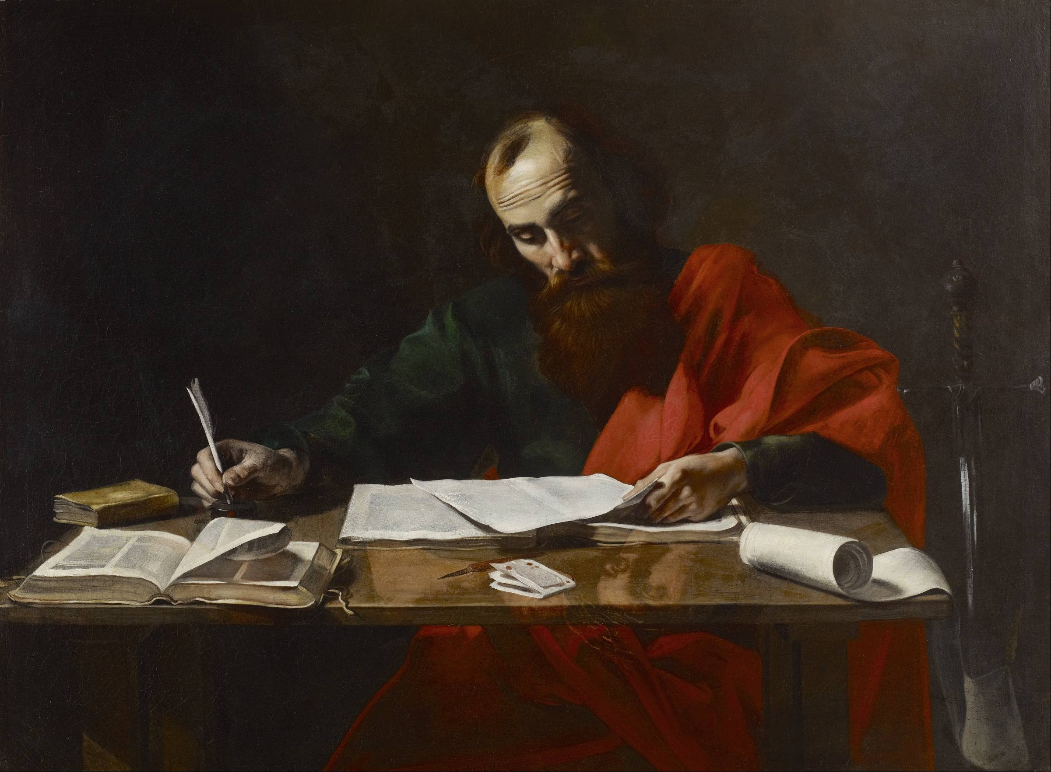
Paul’s Corinthian Advice
1 Corinthians 15
The Resurrection
Notes:
15:12-22

Slide 6
Resurrection
What is the “resurrection”?
Generally, being raised from the dead
Specifically, the belief that:
All dead will be raised and changed
(Not discussed in the Old Testament)
(Not the same as the few dead raised)
Notes:
Joh 5:28 "Do not marvel at this; for an hour is coming, in which all who are in the tombs will hear His voice, 29 and will come forth; those who did the good deeds to a resurrection of life, those who committed the evil deeds to a resurrection of judgment.

Slide 7
Resurrection
What is the “resurrection”?
Jesus was the first (and only so far)
We have a hope of resurrection
Notes:
Joh 5:28 "Do not marvel at this; for an hour is coming, in which all who are in the tombs will hear His voice, 29 and will come forth; those who did the good deeds to a resurrection of life, those who committed the evil deeds to a resurrection of judgment.

Slide 8
Resurrection
One of the fundamentals of Christ
Hebrews 6:1-2
One of the stumbling blocks of men
Acts 17:31-32
What do we know about the resurrection?
Notes:
Heb 6:1 ¶ Therefore leaving the elementary teaching about the Christ, let us press on to maturity, not laying again a foundation of repentance from dead works and of faith toward God, 2 of instruction about washings and laying on of hands, and the resurrection of the dead and eternal judgment.
Ac 17:31 because He has fixed a day in which He will judge the world in righteousness through a Man whom He has appointed, having furnished proof to all men by raising Him from the dead." 32 ¶ Now when they heard of the resurrection of the dead, some began to sneer, but others said, "We shall hear you again concerning this."

Slide 9
Facts of the Resurrection
#1 – it is our body that is raised
For I know that my Redeemer lives, and He shall stand at last on the earth; and after my skin is destroyed, this I know, that in my flesh I shall see God, Whom I shall see for myself, and my eyes shall behold, and not another. How my heart yearns within me! Job 19:25-27
Notes:
1Th 5:23 ¶ Now may the God of peace Himself sanctify you completely; and may your whole spirit, soul, and body be preserved blameless at the coming of our Lord Jesus Christ.

Slide 10
Facts of the Resurrection
#2 – it is NOT our body that is raised
I Corinthians 15:35-44
Now this I say, brethren, that flesh and blood cannot inherit the kingdom of God; nor does corruption inherit incorruption. 1 Corinthians 15:50
Notes:
1Co 15:35 But someone will say, "How are the dead raised up? And with what body do they come?"36 Foolish one, what you sow is not made alive unless it dies.37 And what you sow, you do not sow that body that shall be, but mere grain--perhaps wheat or some other grain. 38 But God gives it a body as He pleases, and to each seed its own body. 39 All flesh is not the same flesh, but there is one kind of flesh of men, another flesh of animals, another of fish, and another of birds. 40 There are also celestial bodies and terrestrial bodies; but the glory of the celestial is one, and the glory of the terrestrial is another. 41 There is one glory of the sun, another glory of the moon, and another glory of the stars; for one star differs from another star in glory. 42 So also is the resurrection of the dead. The body is sown in corruption, it is raised in incorruption.43 It is sown in dishonor, it is raised in glory. It is sown in weakness, it is raised in power. 44 It is sown a natural body, it is raised a spiritual body. There is a natural body, and there is a spiritual body.

Slide 11
Facts of the Resurrection
#3 – it is not clear what happens
Beloved, now we are children of God; and it has not yet been revealed what we shall be… I John 3:2a

Slide 12
Facts of the Resurrection
#4 – Jesus’s is our model of resurrection
…..but we know that when He is revealed, we shall be like Him, for we shall see Him as He is. I John 3:2b

Slide 13
Facts of the Resurrection
#5 – We must believe in the resurrection
It is our hope – Philippians 3:11, Acts 24:15
Dangers of doubt – 2 Timothy 2:18
Notes:
Ac 24:15 "I have hope in God, which they themselves also accept, that there will be a resurrection of the dead, both of the just and the unjust.
Php 3:10 that I may know Him and the power of His resurrection, and the fellowship of His sufferings, being conformed to His death, if, by any means, I may attain to the resurrection from the dead.
2Ti 2:18 who have strayed concerning the truth, saying that the resurrection is already past; and they overthrow the faith of some.

Slide 14
Jesus: Our Resurrection Hope
Jesus said to her, "I am the resurrection and the life. He who believes in Me, though he may die, he shall live.” John 11:25

Slide 16
Two Resurrections
Blessed and holy is the one who has a part in the first resurrection; over these the second death has no power, but they will be priests of God and of Christ and will reign with Him for a thousand years. Revelation 20:6
Notes:
2Ti 2:15 Be diligent to present yourself approved to God as a workman who does not need to be ashamed, accurately handling the word of truth.

Slide 17
Two Resurrections
Or do you not know that all of us who have been baptized into Christ Jesus have been baptized into His death? Therefore we have been buried with Him through baptism into death, so that as Christ was raised from the dead through the glory of the Father, so we too might walk in newness of life. For if we have become united with Him in the likeness of His death, certainly we shall also be in the likeness of His resurrection, Romans 6:3-5
Notes:
2Ti 2:15 Be diligent to present yourself approved to God as a workman who does not need to be ashamed, accurately handling the word of truth.

Slide 18
The Issue: Division
Formation of parties
Denominations: from the name
Paul
Peter
Apollos
Christ

Slide 19
The Issue: Division
Formation of parties
Denominations: from the name
Two kinds of wisdom
From God or from the world

Slide 20
The Issue: Division
But if you have bitter envy and self-seeking in your hearts, do not boast and lie against the truth. This wisdom does not descend from above, but is earthly, sensual, demonic. For where envy and self-seeking exist, confusion and every evil thing are there. James 3:14-16

Slide 21
The Issue: Division
Formation of parties
Denominations: from the name
Two kinds of wisdom
From God or from the world
Christ, Paul, Peter, Apollos were united

Slide 22
The Issue: Division
What causes division?
Envy and self-seeking – James 3:14-16
Carnal minded – 1 Corinthians 3:3
Caught up in our own interests
Immaturity
Notes:
1Co 3:3 for you are still carnal. For where there are envy, strife, and divisions among you, are you not carnal and behaving like mere men?

Slide 23
The Issue: Division
What causes division?
Envy and self-seeking – James 3:14-16
Fault-finders and grumblers – Jude 16-19
Contending for the faith or contentious?
Looking for error
Believe all things – 1 Corinthians 13
Notes:
Jude 1:16 These are grumblers, finding fault, following after their own lusts; they speak arrogantly, flattering people for the sake of gaining an advantage. 17 But you, beloved, ought to remember the words that were spoken beforehand by the apostles of our Lord Jesus Christ, 18 that they were saying to you, "In the last time there will be mockers, following after their own ungodly lusts." 19 These are the ones who cause divisions, worldly-minded, devoid of the Spirit.

Slide 24
The Issue: Division
What causes division?
Envy and self-seeking – James 3:14-16
Fault-finders and grumblers – Jude 16-19
Foolish disputes – Titus 3:9-10
Unresolvable issues
Matters of opinion and liberty

Slide 25
The Solution: Unity
But God composed the body, having given greater honor to that part which lacks it, that there should be no schism in the body, but that the members should have the same care for one another 1 Corinthians 12:24b-25

Slide 26
The Solution: Unity
What establishes unity?
Love for brethren – 1 Corinthians 12:24-25
Putting others above ourselves
Being sacrificial in all things
Patience!
Notes:
1 Co 8:1 Now concerning things offered to idols: We know that we all have knowledge. Knowledge puffs up, but love edifies.

Slide 27
The Solution: Unity
What establishes unity?
Love for brethren – 1 Corinthians 12:24-25
Love for the Truth – John 17:17-23
Doctrine is Truth
No unity without doctrine – 2 John 9
Notes:
Joh 17:17 ¶ "Sanctify them by Your truth. Your word is truth. 18 "As You sent Me into the world, I also have sent them into the world. 19 "And for their sakes I sanctify Myself, that they also may be sanctified by the truth. 20 ¶ "I do not pray for these alone, but also for those who will believe in Me through their word; 21 "that they all may be one, as You, Father, are in Me, and I in You; that they also may be one in Us, that the world may believe that You sent Me. 22 "And the glory which You gave Me I have given them, that they may be one just as We are one: Joh 17:23 "I in them, and You in Me; that they may be made perfect in one, and that the world may know that You have sent Me, and have loved them as You have loved Me.
2Th 2:10 and with all unrighteous deception among those who perish, because they did not receive the love of the truth, that they might be saved.

Slide 28
Pursuing Unity
There is no unity with love alone
Unity must have agreement – Amos 3:3
There is no unity without agreement
The plea of unity – 2 Timothy 3:16-17
Notes:
Am 3:3 Can two walk together, unless they are agreed?

Slide 29
Pursuing Unity
There is no unity with love alone
There is no unity with doctrine alone
There is no such thing as 100%
Patience, love and teaching

Slide 30
Pursuing Unity
There is no unity with love alone
There is no unity with doctrine alone
There is no unity without YOU

Slide 31
Pursuing Unity
Therefore let us pursue the things which make for peace and the things by which one may edify another. Romans 14:19

